Slide 1

Urban Health Explorer: Journeying Through Doctor Appointment Data
Ooha Karuturi, Vidya Karuturi & Mohammed Jafar Sadiqe
Exploratory Data Analysis

Slide 2

Problem Statement/Challenge Outline >
Deploying Data-Driven Insights for Healthcare Optimization: Profiling Top Physicians by Specialization, Experience, and Fees, while Investigating Hyderabad Doctor Availability, Average Fees, and Peak Service Hours to Enhance Urban Healthcare Access and Efficiency.
Focus :
Profiling Top Physicians experience
People consulting Hyderabad Doctor through Online and Offline
Focusing on the best Online website of Doctor Appointment.

Slide 3






Why
Doctor

Slide 4

What ?
Doctor appointments: Scheduled meetings for medical consultations and treatment.
Why ?
Patients discuss health concerns, receive diagnoses, and plan treatment.

Slide 5
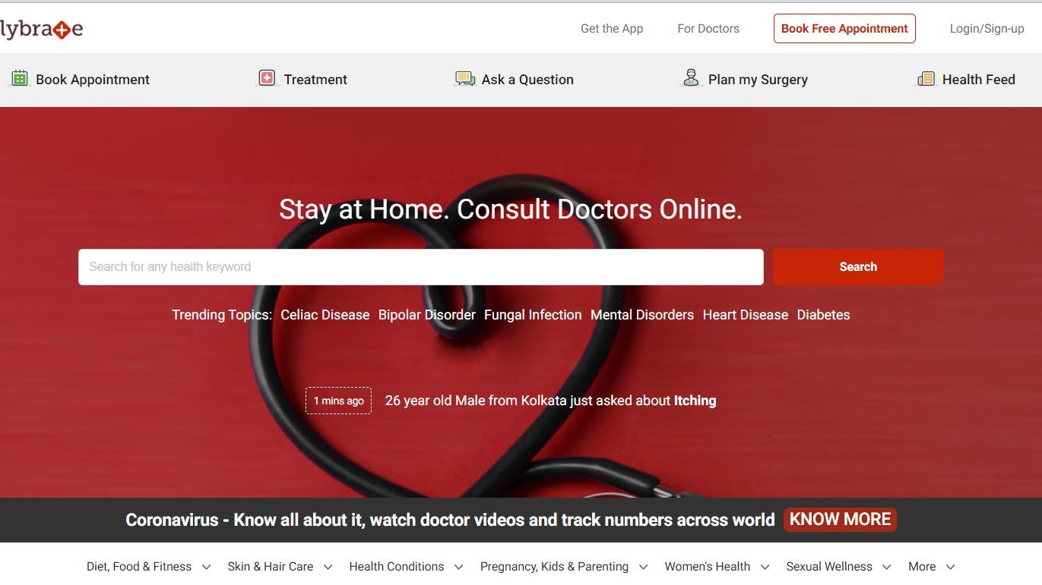


Slide 6
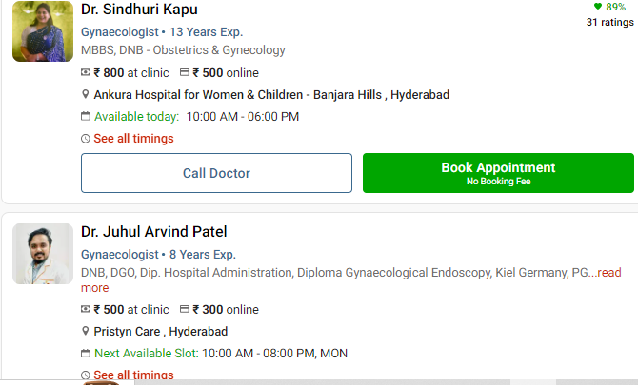
INTERFACE OF THE WEBSITE ALONG WITH HTML:

Slide 7

Flow of Web Scraping :
Store or process the data
Creating dataframe using all the created columns
Saving the data set to local directory
Extract the data
Writing proper conditions
Regex patterns
Using collections types to store the columns
Parse HTML Content
Send HTTP Request using requests.get()
Parsing using ‘BeautifulSoup’
Find Elements: using ‘find_all’ attribute
•
Install and import Required Libraries
Requests
BeautifulSoup
Pandas
Numpy
Regex(re)
Seaborn
Matplotlib

Slide 8
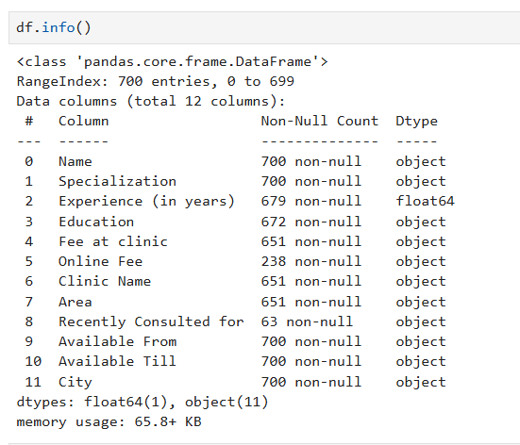
Info of Raw data:

Slide 9

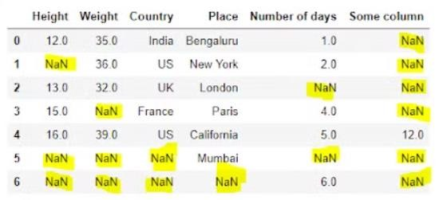

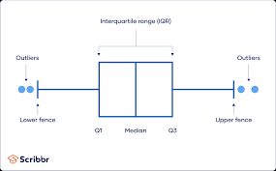
Process (steps involved) in data cleaning :
Identify Missing Values:
Locate and identify missing or null values within the dataset.
Handle Missing Data:
Decide how to handle missing data, either by imputing values, removing rows or columns, or using other techniques.
Address Data Errors:
Correct any errors or inconsistencies in the data, such as typos, incorrect values, or formatting issues.
Detect and Handle Outliers:
Identify outliers, anomalies, or extreme values in the data and decide whether to remove, transform, or adjust them appropriately.
Remove Duplicates:
Identify and remove any duplicate rows or entries in the dataset.
Standardize Data Formats:
Ensure consistency and standardization of data formats across different variables or columns.

Slide 10
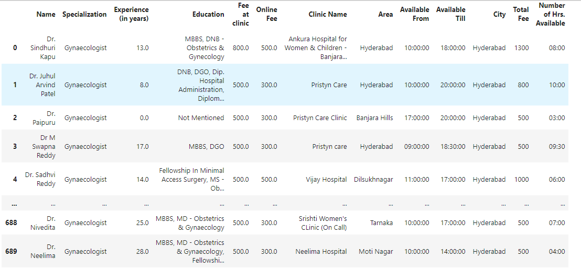
Dataframe after Cleaning :

Slide 11
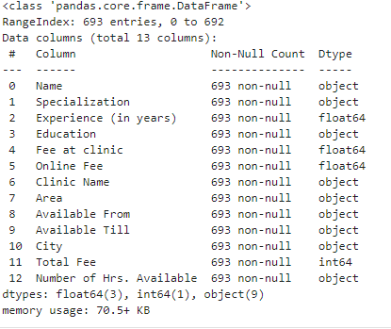
Info of Cleaned data:

Slide 12
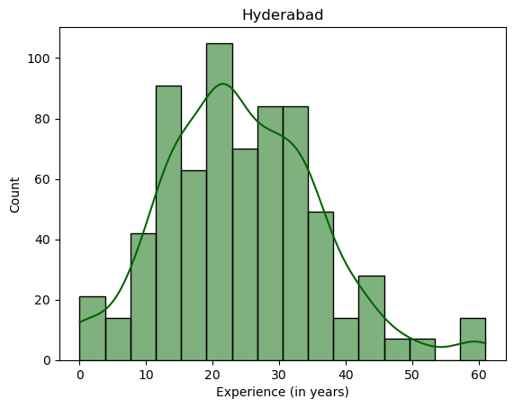
Doctors in Experience Wise :
Hist Plot
What is the Count Of Doctors in Experience Wise?
- From the Histogram plot
1. Highest number of doctors with between 20-30 years of experience
2. Lowest number of doctors with greater than 55 years of experience

Slide 13
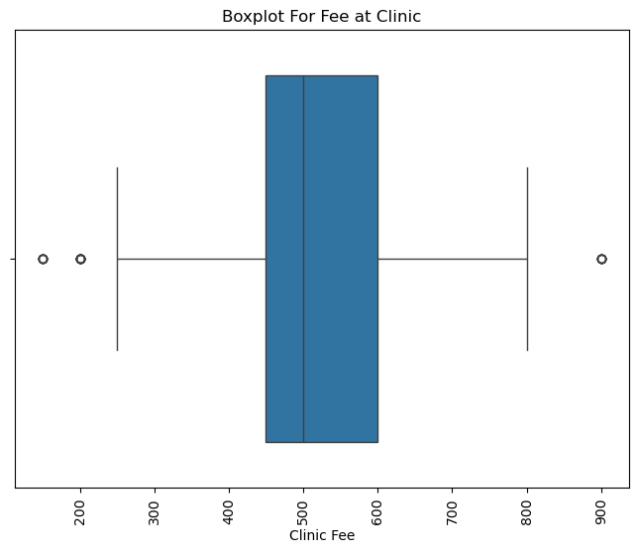
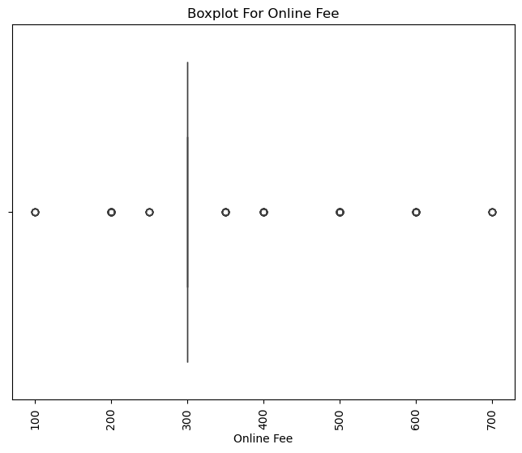
Box Plot for Fee at Clinic V/S Online Fee:

Slide 14
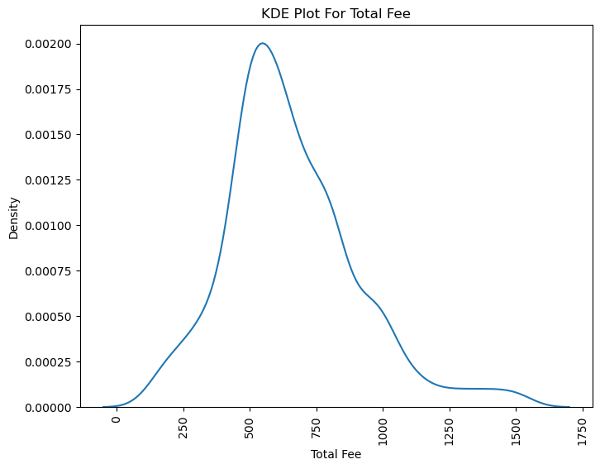
Doctors Total Fee :
KDE Plot

Slide 15
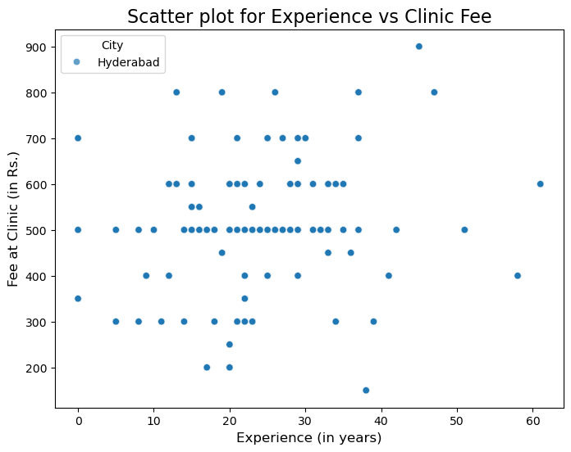
Experience vs Fee at Clinic
From the Scatter plot It Shows how the fee changes with doctors' years of experience.
Insight: You may observe whether more experienced doctors charge higher fees or not.

Slide 16
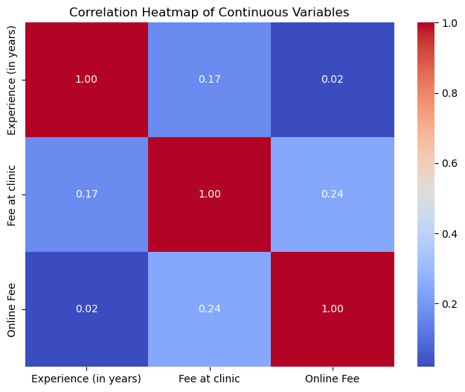
Heat Map for Experience vs Fee at Clinic vs Online Fee

Slide 17
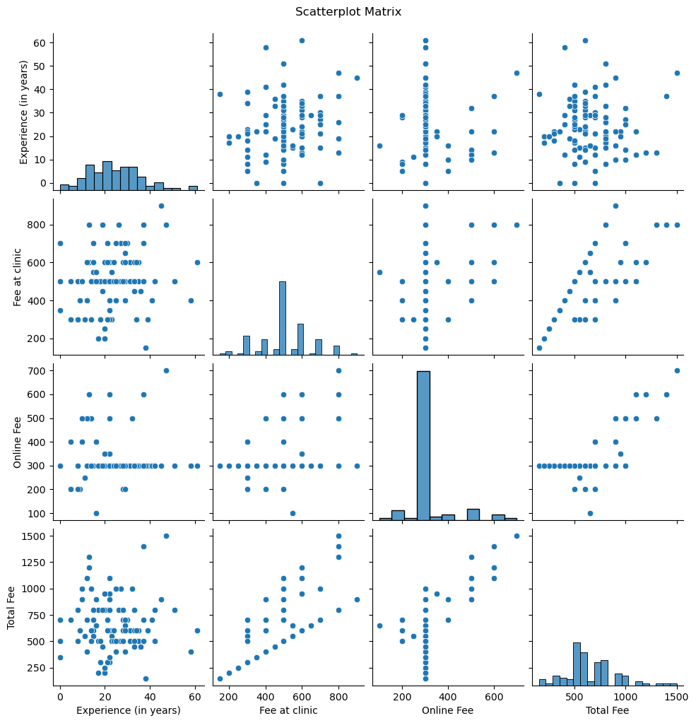
Pair Plot for All the Numeric Columns

Slide 18
Conclusion :
Our data-driven approach has provided valuable insights into various aspects of urban healthcare optimization. By profiling top physicians based on specialization, experience, and fees, we have identified key contributors to healthcare excellence.
Furthermore, our investigation into Hyderabad's doctor availability, average fees, and peak service hours has shed light on crucial factors influencing urban healthcare access and efficiency.
These insights can inform strategic decision-making and resource allocation, ultimately enhancing the delivery of healthcare services in urban areas and improving patient outcomes and satisfaction.

Slide 19
Any Questions?????

Slide 20

THANK YOU

